Slide 1

Plan your journey to retirement
(SIMPLE IRA)
Investments are not FDIC-insured, nor are they deposits of or guaranteed by a bank or any other entity, so they may lose value.
RPGEPO-205-0825O CGD/10235-S102534
© 2025 Capital Group. All rights reserved.
Notes:
[Note to presenter: Welcome the audience, thank them for their time and participation in this event.]
Today we’re going to talk about planning for the future and taking advantage of your employer's SIMPLE IRA retirement plan to help you achieve your goals.
But first, I want to start with the big picture.
[CLICK]

Slide 2

Envision the retirement you want
Notes:
Imagine the life you want to live in retirement.
Do you want to check far away destinations off your bucket list?
Are you looking forward to spending more time at the beach, or taking up birdwatching?
Will you spend more time with your family, or invite your grandkids to your new vacation home?
However you want to spend your retirement, you’ll need a plan to get there. So taking the time now to think about your future can help you take the steps you need to build the retirement you want.
[CLICK]

Slide 3

40%
of an average worker’s income may be replaced by Social Security in retirement.
The rest is up to you.
Source: Social Security Administration, “Retirement Ready,
Fact Sheet For Workers Ages 61-69,” February 2025.
3
Notes:
The reality is that you need a plan for the future.
Social Security may only replace about 40% of your income in retirement. [Source: Social Security Administration, February 2025]
That’ll leave a big gap in your income and it’s up to you to fill it.
Your retirement dreams and — more importantly — your livelihood depend on it.
[CLICK]

Slide 4



Three key questions
How much should
I contribute?
What funds should
I invest in?
How do I stay
the course?
Notes:
When it comes to saving for retirement through your company plan, you’ll need to consider three important questions:
How much should I contribute?
What funds should I invest in?
How do I stay the course?
Or, if you’re already participating in your plan:
Am I contributing enough?
Am I investing in the right funds?
Does my retirement plan still fit my goals?
These may seem like easy questions, but they can be a point of uncertainty and even prevent some people from participating in their company plan or not saving more.
[CLICK]

Slide 5

How much should
I contribute?
Contribute as much
as you can.
Consider aiming for at least 10% to 15% of your salary.
5
Notes:
Let’s tackle the first question: How much should I contribute?
Some financial professionals believe you need to invest 10% to 15% of your salary each year to have enough to live on in retirement.
Don't worry if that seems too difficult at this moment, because even small steps can help you pursue your retirement goals. I'll show you in a minute.
Regardless of what you can invest now, what’s important is that you start investing as soon as possible.
By doing so, you're taking advantage of the time and the opportunity for your investment earnings to grow. The sooner you get started, the longer your investments have to work for you.
[CLICK]

Slide 6



Contribute more
Employers with
25 or fewer employees
Employers with
26-100 employees
Participant contribution limit for tax
year 2025:
$17,600
$17,600¹] / $16,500
Employee contributions
$3,850
(age 50–59 and 64+)
$3,850¹ / $3,500
(age 50–59 and 64+)
Additional catch-up contribution² limit for those age 50 and older:
$5,250³ (age 60–63)
A dollar-for-dollar match of participant contributions up to:
3%
of compensation
3%
of compensation
Mandatory employer contributions; either…
OR
A non-elective contribution⁴ of:
2%
of compensation
2%
of compensation
Above mandatory contributions, employers can elect to make additional non-elective contributions to each eligible employee in a uniform percentage, up to:
Optional additional employer contributions
10% of compensation, not to exceed $5,100
Contribution limits shown apply to SIMPLE IRAs.
¹ The higher limit applies to larger employers (those with more than 25 employees who earned at least $5,000 in the prior year) if the employer elects to increase matching contributions to 4% or non-elective contributions to 3%.
² If permitted by the plan.
³ This higher catch-up limit is effective January 1, 2025, and is only applicable to participants who attain ages 60, 61, 62, or 63 in 2025.
⁴ The percentage of mandatory employer non-elective contributions is applied on up to $350,000 of compensation for 2025.
Notes:
[If the plan has a $17,600 limit]
A SIMPLE IRA can also help you save more for retirement. In 2025, the IRS lets you contribute up to $17,600 of your own money to a SIMPLE IRA. That's more than double what you could save if you opened a traditional or Roth IRA on your own.
If you're 50 or older, the IRS lets you save an extra $3,500 a year to help you catch up on your retirement goals, or up to $3,850 a year under certain circumstances. For those who turn age 60, 61, 62 or 63 in 2025, there is a higher catchup contribution limit of $5,250.
One valuable benefit of a SIMPLE IRA is that your employer will also contribute money for you into your account.
These employer contributions are free money that can help you save more and move you closer to your retirement goals.
[If the plan has a $16,500 limit]
A SIMPLE IRA can also help you save more for retirement. In 2025, the IRS lets you contribute up to $16,500 of your own money to a SIMPLE IRA. That's more than double what you could save if you opened a traditional or Roth IRA on your own.
If you're 50 or older, the IRS lets you save an extra $3,500 a year to help you catch up on your retirement goals, or up to $3,850 a year under certain circumstances. For those who turn age 60, 61, 62 or 63 in 2025, there is a higher catchup contribution limit of $5,250.
One valuable benefit of a SIMPLE IRA is that your employer will also contribute money for you into your account.
These employer contributions are free money that can help you save more and move you closer to your retirement goals.
[Provide details on the specific plan’s employer matching or nonelective contributions]
How much you save depends on how much you make, how much you contribute and how your company contributes.
Plus, all of the contributions vest immediately, including the money your employer puts in. That means that everything that goes into the account is yours to keep, even if you leave the company. This, of course, is subject to any potential declines in value that your investments may experience over time.
[OPTIONAL, depending on what the plan offers]
And plans may now provide additional employer contributions to eligible employees uniformly, up to the lesser of $5,100 or 10% of compensation.
[CLICK]

Slide 7




Start investing as soon as you can
Start now
Adrian saves $200 per month for 40 years.
Catch up later
By waiting just 10 years to start,
even twice the monthly contribution isn’t enough to catch up.
Mai saves $400 per month for 30 years.
7
Notes:
When it comes to investing for retirement, time can be one of your greatest allies.
In this hypothetical example, we see the power of time — and the cost of delay.
On the top is an investment of $200/month for 40 years. This results in a monthly retirement withdrawal of $2,343.
More time in the market gives your investments more opportunity to grow through compounding.
On the bottom is an investment of $400/month for 30 years. This results in a monthly retirement withdrawal of $2,000.
By waiting just 10 years to start investing, even twice the monthly contribution wasn’t enough to catch up.
To further emphasize the power of time, let’s look at the total investments:
$200/month for 40 years of your career is $96,000.
$400/month for 30 years is $144,000.
That’s 1.5 times MORE contributions for nearly $350 LESS in monthly
retirement withdrawals.
Time has the potential to help you EARN MORE with LESS MONEY.
Have you heard the saying, “the days are long, but the years are short”?
Ten years can go by quickly, so don’t put off saving.
The most important decision you can make about investing for retirement is just that — to invest.
[CLICK]

Slide 8




Small steps can help you get there
No increases
Antonio saves 6% of his pay until retirement.
$2,914
per month
difference
Small increases
Sara increases her 6% contribution by 1% each year until it reaches 12%.
Notes:
Now, as I said, you don’t need to start contributing 10% to 15% right away; you can start small and work your way up. If you’re already contributing to your plan, now is a great time to think about whether you can increase your contributions even more.
Let’s see what that might look like and how it can make a big difference over time.
In this hypothetical example, Antonio starts saving with a 6% contribution and he sticks with it until retirement.
Sara also starts saving with a 6% contribution, but she increases her contribution by just 1% each year until it reaches 12%.
Look at the difference those small increases made over time: Sara would have an extra $2,914 in her monthly retirement withdrawals.
That money could help Sara live the life she wants in retirement.
[CLICK]

Slide 9

Take advantage of tax benefits
Pretax employee contributions reduce your taxable income, so you pay lower taxes.
That means that saving won’t cost you as much.
Notes:
You can also take advantage of potential tax benefits by saving for retirement.
When you make pretax contributions to your retirement plan, you can reduce your taxable income. That means you may reduce your current taxes for the year.
That also means that your savings don’t make as big of a dent in your paycheck. For example, if your tax rate was 25%, saving $400 a month would only reduce your paycheck by $300.
When the time comes to make a withdrawal, you’ll pay taxes on your contributions and earnings based on your future tax rate.
While your future tax rate could be higher than your current rate, many people expect to be in a lower tax bracket when they're retired.
[If the plan offers Roth contributions]
Your plan allows Roth after-tax contributions, which are made with money that's already been taxed, but qualified withdrawals, including earnings, are tax-free.
[CLICK]

Slide 10

What funds should
I invest in?
Choose investments that align with your goals.
10
Notes:
Now another key question: What funds should I invest in?
When it comes to choosing or evaluating your investments, there are a few things to consider:
What’s your risk tolerance?
How much time do you have to invest?
Do you have any other investments?
Then it’s a matter of finding funds that are aligned with your retirement goals.
Developing a diverse mix of investments based on your objectives can help you pursue the retirement that you envision.
[CLICK]

Slide 11
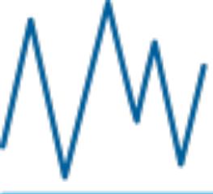
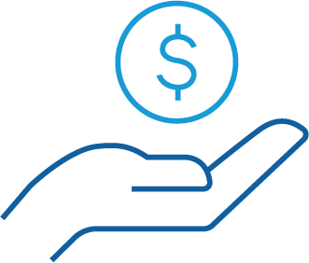

Access a full range of investment options
Growth-oriented investments have had higher risk and
return potential.
Income-oriented investments have typically shown lower risk and
return potential.
Capital preservation investments aim to preserve your savings but have low return potential.
Notes:
Your retirement account offers a full range of investments. Working with a financial professional can help you navigate the options here.
First, a brief overview:
Growth-oriented investments, like stock funds, typically have had the highest long-term return potential, which may help you reach your retirement goals. But they can also carry the highest potential risk. If you’re far away from retirement, you might consider growth-oriented funds since you’ll have more time to potentially recover from losses the funds may experience..
Income-oriented investments, like bond funds, have typically demonstrated lower risk and return potential compared to equity-focused investments. If you’re closer to retirement, you may consider income-oriented funds to help you preserve the money you've invested while still having some potential to seek income.
And capital preservation investments, like money market funds, are intended to preserve what you’ve saved. That means they have low risk. But they also may not provide the growth you’ll need to meet your retirement goals. Also, while they seek to maintain the value of your investment at $1.00 per share, they are not guaranteed to do so.
You can build a portfolio using a mix of investment types based on your goals, how far you are from retirement and how much risk you can stomach, as all investments have the potential to lose value.
[CLICK]

Slide 12
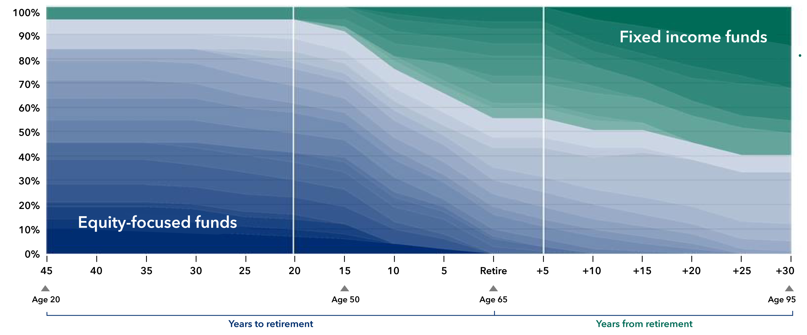
Target date funds simplify investing
Early career
Mid-career
In retirement
Seek to grow wealth and manage risk with growth-oriented equities and a prudent allocation to defensive bonds.
Begin to balance growth and income via diversified bonds and dividend-paying equities.
Seek to preserve wealth and deliver sustainable income with less-volatile dividend-paying equities and higher quality bonds.
American Funds Target Date Retirement Series glide path by individual underlying fund allocation and overall fund category
Although target date portfolios are managed for investors on a projected retirement date time frame, the allocation strategy does not guarantee that investors' retirement goals will be met. Investment professionals manage the portfolio, moving it from a more growth-oriented strategy to a more income-oriented focus as the target date gets closer. The target date is the year that corresponds roughly to the year in which an investor is assumed to retire and begin taking withdrawals. For the American Funds target date series, investment professionals continue to manage each portfolio for approximately 30 years after it reaches its target date.
The target allocations shown for the American Funds series are as of December 31, 2024, and are subject to the oversight committee's discretion. The investment adviser anticipates assets will be invested within a range that deviates no more than 10% above or below the allocations shown in the prospectus. Underlying funds may be added or removed during the year. Visit capitalgroup.com for current allocations.
Notes:
If that sounds too confusing, a simpler route to consider is choosing a target date fund based roughly on the year you plan to retire and begin taking withdrawals.
Think of it like an autopilot feature for your investments.
This chart, which is called a glide path, helps show how the investments in a target date fund change over time:
Moving left to right, you see that growth investments, like stock funds, play a larger role in each fund’s makeup or mix when the target retirement date is years away. That’s because stocks have potential for higher returns, but they're also more vulnerable to market declines.
As you continue toward the target retirement date, which is the year that corresponds roughly to the year in which you intend to retire and begin taking withdrawals, the mix gradually shifts to include more fixed income investments, like bond funds. Bonds tend to rise and fall less dramatically than stocks, but typically don't offer as much potential for growth.
This approach helps emphasize investment growth when you’re younger — when your investments can take on more market risk because you have the benefit of time on your side — and can also help reduce the impact of market declines as you near retirement and start preparing to take retirement withdrawals.
[OPTIONAL FOR PLANS USING THE AMERICAN FUNDS TARGET DATE RETIREMENT SERIES:] The funds in the American Funds Target Date Retirement Series are also managed for approximately 30 years beyond the target retirement date. So, the allocation to bonds continues to increase through retirement, which can help provide a measure of protection during market declines.
This easy investment approach can be an appealing option for investors who don’t want to spend a lot of time and effort choosing and monitoring their own investments.
[CLICK]

Slide 13

Choosing a target date fund is easy
When do you plan to retire?
1986
65
2051
+
=
Year you were born
Approximate retirement year
Check the box next to the target date fund that’s closest to your retirement year.
2070
2065
2060
2055
2050
2045
2040
2035
2030
2025
2020
2015
2010
Notes:
[OPTIONAL: TARGET DATE FUND OPTION]
Choosing a target date fund is easy too:
Start with your birth year and add 65 to determine your approximate retirement year.
Then find the target date fund that’s closest to your retirement year.
It’s that easy.
Keep in mind, this equation assumes that you’ll begin taking retirement withdrawals at age 65.
If you plan to begin taking withdrawals before or after age 65, you may want to consider another target date fund that better aligns with your retirement goals.
[CLICK]

Slide 14

How do I stay the course?
Stay focused on your
retirement plan.
14
Notes:
Now, let’s talk about how to stay on course. The best thing to do is stay focused on your retirement plan — even through market swings.
[CLICK]

Slide 15

Tune out the noise
15
Notes:
How many of you have some sort of smart device on you right now?
From phones and watches to TVs in elevators and at gas pumps; it’s hard to escape the 24/7 news cycle.
And that means it’s easier than ever to get caught up in the buzz of headlines.
You’ve heard it before: One minute the economy is great and the next minute it’s doom and gloom.
One thing is true though: As you save for retirement, you’ll see many market ups and downs. That's natural.
That means you need to tune out the noise and keep a long-term perspective to help you succeed.
[CLICK]

Slide 16


A long-term approach can pay off
A hypothetical investment in the S&P 500 Index over 30 years (1995–2024) with dividends reinvested
$
Notes:
I know that keeping a long-term perspective might be easier said than done — especially when the market drops — but it can pay off.
Look at this hypothetical $1,000 investment in the S&P 500 Index over 30 years:
In some years, the returns were DOWN more than one-third of their value. So, some investments may have lost value.
In other years, the returns were UP more than one-third of their value.
Don’t get wrapped up in the highs and lows.
What really matters is the big picture: Over 30 years, this one-time investment grew to more than $22,000.
Obviously, you'll need to invest more than $1,000 for retirement but this hypothetical example shows the potential in staying invested.
[CLICK]

Slide 17




The value of a return
Bruce keeps his money out of the market
and does not earn a return.
He saves $1,000 per month.
$1,329
per month
difference
Allison invests in a hypothetical
investment earning 8% annual return.
She invests $250 per month — ¼ of what Bruce saves!
Notes:
While braving market dips and dives might seem daunting, it may be the key to achieving your retirement goals.
In this example, Bruce keeps his money out of the market. He saves $1,000 a month in cash.
Meanwhile, Allison puts her money in growth-oriented funds.
Even though Allison only saves $250 a month — just a quarter of what Bruce saves! — after 40 years of saving she would have nearly $3,000 a month to withdraw — over $1,300 more than Bruce.
[CLICK]

Slide 18
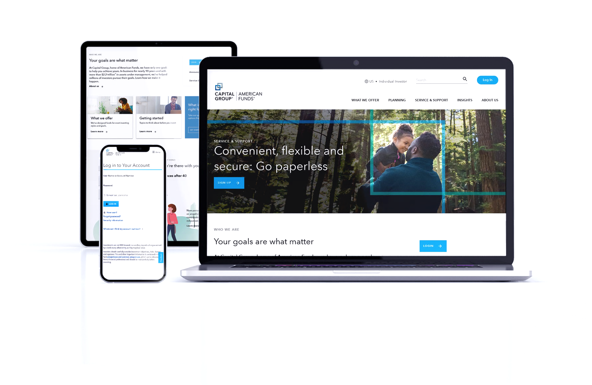
Savings, made simple
Set up automatic deferrals, then monitor your account online.
SIMPLE IRA: capitalgroup.com
SIMPLE IRA Plus: capitalgroup.com/
participant/simpleiraplus
Notes:
A SIMPLE IRA makes setting and following your retirement plan easy. Your contributions come out of your paycheck automatically, so you just decide how much to save and how to invest it.
If you’re interested in getting started, all you have to do is get an application form from your employer. The application also lets you choose which investments you want to use in each account, and everything will be set up for you from there. You can always make changes to your savings rate or your investments later.
Once you have an account, log in to your website to monitor your progress. Online content and tools may help you stay on track. SIMPLE IRA participants can log in at capitalgroup.com. SIMPLE IRA Plus participants can log in at capitalgroup.com/participant/simpleiraplus.
[CLICK]

Slide 19
Remember these key takeaways:
Contribute what you can
and increase it over time.
Choose investments
that align with your goals.
Stay focused
on your retirement plan.
19
Notes:
We've covered a lot of info today to help you on your journey to retirement; I want you to remember three key things:
First, we talked about choosing a contribution rate that makes sense for you.
What’s important is that you contribute what you can now, then consider increasing your contribution amount over time.
You’ll also benefit from the contributions your employer makes on your behalf.
[OPTIONAL FOR PLANS WITH MATCHING CONTRIBUTIONS]: Make sure you’re getting your full employer match so you don’t leave money on the table.
Then we talked about choosing investments that are aligned with your goals.
[OPTIONAL]: Consider target date funds if you want a simplified "do it for me" approach
to investing.
Finally, we talked about the importance of staying focused on your investment plan.
It makes sense to re-evaluate your plan from time to time, but don’t let the day-to-day news or market hiccups interfere with your plan.
History has shown that a long-term investment approach has potential to help you pursue a better outcome.
With a little planning, retirement can be an exciting and fulfilling part of life, so thank you for taking the time to meet with me today.
I hope our conversation today has helped you think about your investment plan.
I encourage you to speak with me or your employer if you have any questions about investing for retirement.
[CLICK]

Slide 20
Investors should carefully consider investment objectives, risks, charges and expenses. This and other important information is contained in the fund prospectuses and summary prospectuses, which can be obtained from a financial professional and should be read carefully before investing.
Statements attributed to an individual represent the opinions of that individual as of the date published and do not necessarily reflect the opinions of Capital Group or its affiliates. This information is intended to highlight issues and should not be considered advice, an endorsement or a recommendation.
All Capital Group trademarks mentioned are owned by The Capital Group Companies, Inc., an affiliated company or fund. All other company and product names mentioned are the property of their respective companies.
Capital Client Group, Inc.
This content, developed by Capital Group, home of American Funds, should not be used as a primary basis for investment decisions and is not intended to serve as impartial investment or fiduciary advice.
The S&P 500 Index (“Index”) is a product of S&P Dow Jones Indices LLC and/or its affiliates and has been licensed for use by Capital Group. Copyright © 2025 S&P Dow Jones Indices LLC, a division of S&P Global, and/or its affiliates. All rights reserved. Redistribution or reproduction in whole or in part is prohibited without written permission of S&P Dow Jones Indices LLC.
Although the target date portfolios are managed for investors on a projected retirement date time frame, the allocation strategy does not guarantee that investors’ retirement goals will be met. Investment professionals manage the portfolio, moving it from a more growth-oriented strategy to a more income-oriented focus as the target date gets closer. The target date is the year that corresponds roughly to the year in which an investor is assumed to retire and begin taking withdrawals. Investment professionals continue to manage each portfolio for approximately 30 years after it reaches its target date.
© 2025 Capital Group. All rights reserved.

