Slide 1


Prospering through downturns
Investments are not FDIC-insured, nor are they deposits of or guaranteed by a bank or any other entity, so they may lose value.
MFCPPO-004-0426 8181-S110666
© 2026 Capital Group. All rights reserved.
Notes:
Shareholders often ask what we at Capital Group, home of American Funds®, think will happen to the market.
– Even if we had a crystal ball, it would be impossible to predict the future.

Slide 2
“We do not have, never have had, and never will have an opinion about where the stock market, interest rates, or business activity will be a year from now.”
Warren Buffett,
Berkshire Hathaway shareholder letter, 1988
© 2026 Capital Group. All rights reserved.
Notes:
“We do not have, never have had, and never will have an opinion about where the stock market, interest rates, or business activity will be a year from now.”
That’s not just my opinion; it’s the view of Warren Buffett, the nation’s most famous investor. Mr. Buffett included this statement in his 1988 letter to the shareholders of Berkshire Hathaway.
At Capital Group, we don’t know what will happen to the market either. But there are a few things on which we can all agree.

Slide 3
What we know for sure
© 2026 Capital Group. All rights reserved.
Notes:
That’s what I’d like to talk to you about today: What we know for sure.
I’m going to illustrate for you some things we know for sure, using stories from our ICA Guide.
While these stories happen to feature The Investment Company of America, or ICA, a
92-year-old growth and income fund, their lessons are meant to illustrate concepts and strategies that address many of the concerns today’s investors may have.

Slide 4

What we know for sure
Diversification can help
reduce risk
© 2026 Capital Group. All rights reserved.
Notes:
The first thing we know for sure is that diversification can help reduce risk.
Let’s illustrate this idea with a quick quiz.

Slide 5
Investing in stocks requires skill
Dow Jones Industrial Average
3M
Amazon
American Express
Amgen
Apple
Boeing
Caterpillar
Chevron
Cisco Systems
Coca-Cola
Goldman Sachs Group
Home Depot
Honeywell International
International Business Machines (IBM)
Johnson & Johnson
JPMorgan Chase
McDonald's
Merck
Microsoft
NIKE
NVIDIA
Procter & Gamble
Salesforce
Sherwin-Williams
Travelers Companies
UnitedHealth Group
Verizon Communications
Visa
Walmart
Walt Disney
Dow Jones Industrial Average (DJIA) is a price-weighted average of 30 actively traded industrial and service-oriented blue chip stocks. List is as of December 31, 2025.
© 2026 Capital Group. All rights reserved.
Notes:
Here are the 30 stocks of the Dow Jones Industrial Average — also known as the DJIA — as of December 2025. These are companies that you’ve all heard of.
Let’s turn back the clock and pretend that in 1934 you could have invested $1,000 apiece in any five of the stocks in the index.
Keep in mind that the companies in the DJIA have changed over time. For this comparison, we’re assuming that when one company in the index was replaced by another, proceeds from the sale of shares in the original company were invested in the new company.
As you look at this list, I’d like you to write down the five stocks you think would have been the best investments over the past 91 years.

Slide 6

Investing in stocks requires skill
If you could have invested $1,000 each in any five of these companies (or their predecessors) 91 years ago, which five would you choose?
Dow Jones Industrial Average
3M
Amazon
American Express
Amgen
Apple
Boeing
Caterpillar
Chevron
Cisco Systems
Coca-Cola
Goldman Sachs Group
Home Depot
Honeywell International
International Business Machines (IBM)
Johnson & Johnson
JPMorgan Chase
McDonald's
Merck
Microsoft
NIKE
NVIDIA
Procter & Gamble
Salesforce
Sherwin-Williams
Travelers Companies
UnitedHealth Group
Verizon Communications
Visa
Walmart
Walt Disney
Dow Jones Industrial Average (DJIA) is a price-weighted average of 30 actively traded industrial and service-oriented blue chip stocks. List is as of December 31, 2025.
© 2026 Capital Group. All rights reserved.
Notes:
These five stocks represented the highest returns from 1934 to 2025 on a $1,000 investment in each of these companies and their DJIA predecessors from 1934 to 2025.
– How this works is when one company in the index was replaced by another, proceeds from the sale of the original company were invested in the new one.
– Based on that strategy, today you would have had a portfolio including the five companies that are checked on this slide.

Slide 7
Investing in stocks requires skill
Hypothetical $1,000 investment, 1/1/34–12/31/25
Cumulative ending value
If you had invested $1,000 in any of the
five stocks, your investment would have significantly trailed a $1,000 investment in ICA.
Figures shown are past results and are not predictive of results in future periods. Current and future results may be lower or higher than those shown. Prices and returns will vary, so investors may lose money. Investing for short periods makes losses more likely. Fund results are for Class A shares and reflect deduction of the maximum sales charge (5.75%). For current information and month-end results, visit capitalgroup.com.
The Investment Company of America® (ICA) | $3,139,530
Procter & Gamble | 1,422,703
Home Depot | 575,085
Microsoft | 567,274
McDonald’s | 553,303
Visa | 528,937
Dividends taken in cash. It was assumed that the entire $1,000 was invested in each stock and that fractional shares were purchased where required to use up the full amount. No brokerage charges were included in the cost. Adjustments were made for all stock splits, stock dividends and spinoffs. Companies shown represent holdings as of 12/31/25. When one company in the index was replaced by another, proceeds from the sale of the original company were invested in the new one. Based on that strategy, today you would have a portfolio including the five companies shown above.
© 2026 Capital Group. All rights reserved.
Notes:
Here are the results for those stocks based on a hypothetical $1,000 investment 92 years ago.
When you look at the hypothetical growth of the companies shown, you see that not one of the DJIA's stocks would have outpaced an investment in ICA, even though some of the other companies may have done better than ICA at various points during their lifetimes.
Keep in mind that the process of replacing one Dow stock can often mean selling low (when a stock is being removed from the index) and buying high (when a new stock is added to the index).
Investment management can make a meaningful difference over time.
ICA's investment professionals draw on long experience and in-depth research for the fund's portfolio of holdings.
With ICA’s diversified portfolio, your $1,000 investment would have grown to more than $3 million as of December 31, 2025.
If you had invested $1,000 in any of the five stocks, your investment would have significantly trailed a $1,000 investment in ICA.

Slide 8
What we know for sure
Successful investors look beyond short-term fluctuations
© 2026 Capital Group. All rights reserved.
Notes:
So, we know that diversification can help reduce risk. What else do we know for sure? Well, we know that successful investors look beyond short-term fluctuations.

Slide 9




There have always been reasons not to invest
© 2026 Capital Group. All rights reserved.
Notes:
Throughout ICA’s 92 years, there have been events that could have caused investors not to invest.
Many investors may be tempted to base investment decisions on emotion — especially when events like the war in Iraq occur. But, historically, ICA has given its shareholders good reason to look beyond the day’s headlines.
Let’s look at a few examples.

Slide 10
There have always been reasons not to invest
The Investment Company of America
Figures shown are past results and are not predictive of results in future periods. Current and future results may be lower or higher than those shown. Prices and returns will vary, so investors may lose money. Investing for short periods makes losses more likely. Fund results are for Class A shares and reflect deduction of the maximum sales charge (5.75%). For current information and month-end results, visit capitalgroup.com.
Hypothetical $10,000 investment on these historic days
Ending value
12/31/25
8/9/74 – President Nixon resigned $4,109,433
10/19/87 – DJIA declined 22% 568,785
8/2/90 – Gulf War started 362,957
9/11/01 – September 11 terrorist attack 87,419
Results with all distributions reinvested.
© 2026 Capital Group. All rights reserved.
Notes:
Here’s what would have happened if you had made a hypothetical $10,000 investment in ICA on the day that:
President Nixon resigned (August 9, 1974).
By the end of 2025, you would have had $4,109,433.
The Dow Jones Industrial Average dropped a record 22% in one day, known as Black Monday (October 19, 1987).
By the end of 2025, you would have had $568,785.
Iraqi troops invaded Kuwait, setting off the first Gulf War (August 2, 1990).
By the end of 2025, you would have had $362,957.
Terrorists attacked U.S. sites, including the World Trade Center (September 11, 2001).
By the end of 2025, you would have had $87,419.
(Results assume deduction of the maximum 5.75% sales charge for Class A shares, with all distributions reinvested.)

Slide 11

What we know for sure
When investing, time is more important than timing
© 2026 Capital Group. All rights reserved.
Notes:
I think we can also agree that, in the world of investing, time is more important than timing.
Here’s a familiar story to illustrate that point.

Slide 12

Think you
have bad
timing?
Meet
Louie
the Loser
© 2026 Capital Group. All rights reserved.
Notes:
Do you worry about bad timing when it comes to investing?
Let me introduce Louie the Loser, one of our most famous fictional characters.
Louie canceled his dental insurance the day before his root canal flared up. His vacation in
the desert was rained out. Louie couldn’t have worse timing.
So, why does he look so happy? Let’s find out.
Twenty years ago, Louie decided he should do some investing — $10,000 every year.
– Of course, regular investing does not ensure a profit or protect against loss. Investors should consider their willingness to keep investing when share prices are declining.
Considering the type of guy he is, it’s no surprise that each year when he told his financial professional to invest $10,000 in ICA, it was on the very day the stock market hit its highest point that year. In other words, it was the worst day he could have picked because on all the other days that year, the market was lower.
– By the way, when I say “the market,” I’m referring to the Dow Jones Industrial Average, an unmanaged index comprising a price-weighted average of 30 actively traded industrial and service-oriented blue chip stocks.
Twenty years of investing on the worst possible day. Anyone want to venture a guess as to how Louie did?

Slide 13
Louie the Loser
As of 12/31/25
Figures shown are past results and are not predictive of results in future periods. Current and future results may be lower or higher than those shown. Prices and returns will vary, so investors may lose money. Investing for short periods makes losses more likely. Fund results are for Class A shares and reflect deduction of the maximum sales charge (5.75%). For current information and month-end results, visit capitalgroup.com.
Hypothetical $10,000 a year in ICA, starting in 2006:
Worst-day investments (market highs)¹
Best-day investments (market lows)²
Ending value $694,213
Average annual total return 11.47%
Ending value $904,175
Average annual total return 13.23%
¹Dates used include 3/4/05, 12/27/06, 10/09/07, 5/2/08, 12/30/09, 12/29/10, 4/29/11, 10/5/12, 12/31/13, 12/26/14, 5/19/15, 12/20/16, 12/28/17, 10/3/18, 12/27/19, 12/31/20, 12/29/21, 1./4/22, 12/28/23,
12/4/24 and 12/24/25.
²Dates used include 4/20/05, 1/20/06, 3/5/07, 11/20/08, 3/9/09, 7/2/10, 10/3/11, 6/4/12, 1/8/13, 2/3/14, 8/25/15, 2/11/16, 1/19/17, 12/24/18, 1/3/19, 3/23/20, 1/29/21, 9/30/22, 3/13/23, 1/17/24 and 4/8/25.
The average annual total returns shown take into account subsequent investments. Market highs and lows based on Dow Jones Industrial Average. Louie is a fictional character, and his results are for illustrative purposes only. Cumulative volume discount applied when appropriate.
© 2026 Capital Group. All rights reserved.
Notes:
It may be hard to believe, but despite an almost superhuman knack for picking the worst day — the day the market hit its high — Louie did just fine.
Over 20 years, he invested $200,000, and by December 31, 2025, that had grown to $694,213 — an average annual total return of 11.47%. Not too bad for a guy with a terminal case of bad timing.
Now, if Louie had had perfect timing and invested on the best day each year — the day the market hit its low — he would have done better.
His investment would have grown to $904,175, and he would have seen an average annual total return of 13.23%.
Of course, anyone else investing $10,000 a year in ICA over that same period would most likely have had different timing and results than Louie’s.
However, we can realistically expect that if we invest regularly, while our timing won’t be perfect, it won’t be as bad as Louie’s either.

Slide 14
What we know for sure
Flat markets can present opportunities
© 2026 Capital Group. All rights reserved.
Notes:
What else do we know for sure? We also know that flat markets can present opportunities for investors.

Slide 15
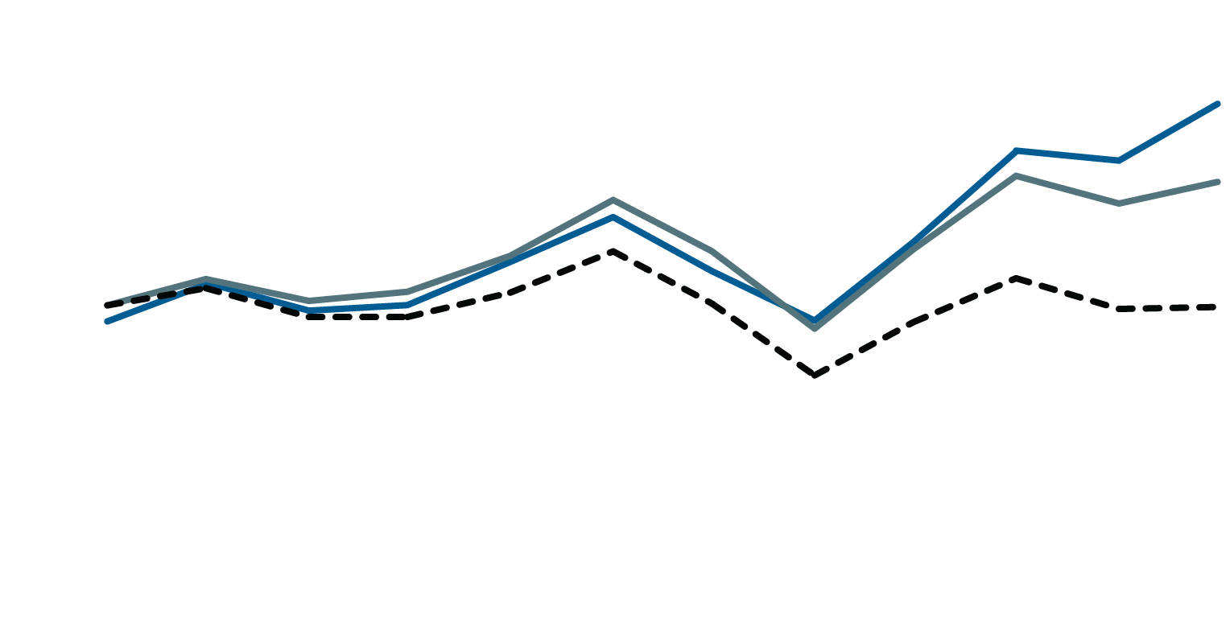
ICA vs. the S&P 500 index
A Hypothetical $10,000 investment in a relatively flat market, 12/31/67–12/31/78
Ending value
Figures shown are past results and are not predictive of results in future periods. Current and future results may be lower or higher than those shown. Prices and returns will vary, so investors may lose money. Investing for short periods makes losses more likely. Fund results are for Class A shares and reflect deduction of the maximum sales charge (5.75%). For current information and month-end results,
visit capitalgroup.com.
$20,000
$18,333
ICA with dividends reinvested
15,000
$15,174
S&P 500
with
dividends reinvested
10,000
$9,963
S&P 500
5,000
1968
1969
1970
1971
1972
1973
1974
1975
1976
1977
1978
There have been periods when the fund has lagged the index.
© 2026 Capital Group. All rights reserved.
Notes:
While the Great Recession from October 9, 2007, through March 9, 2009, and the more recent COVID-19 pandemic decline from February 19, 2020, through March 23, 2020, were incredibly challenging for investors and the markets, there have been other, less dramatic declines, as well as periods of little change at all.
But during difficult times, ICA’s professional management has frequently enabled the fund to do better than the market.
The chart on this slide, and the one on the next, show how ICA compared to the S&P 500 during two past market periods that were relatively “flat.”
On this slide:
– S&P 500 Index began 1968 with an index value of 96.47.
– More than a decade later, at the end of 1978, it stood at 96.11 — right back where it had started. But an investor still could have made money.
– A hypothetical investment of $10,000 in the S&P 500, with reinvested dividends, would have grown to $15,174.
– Meanwhile, that $10,000 invested in ICA would have grown to $18,333.

Slide 16
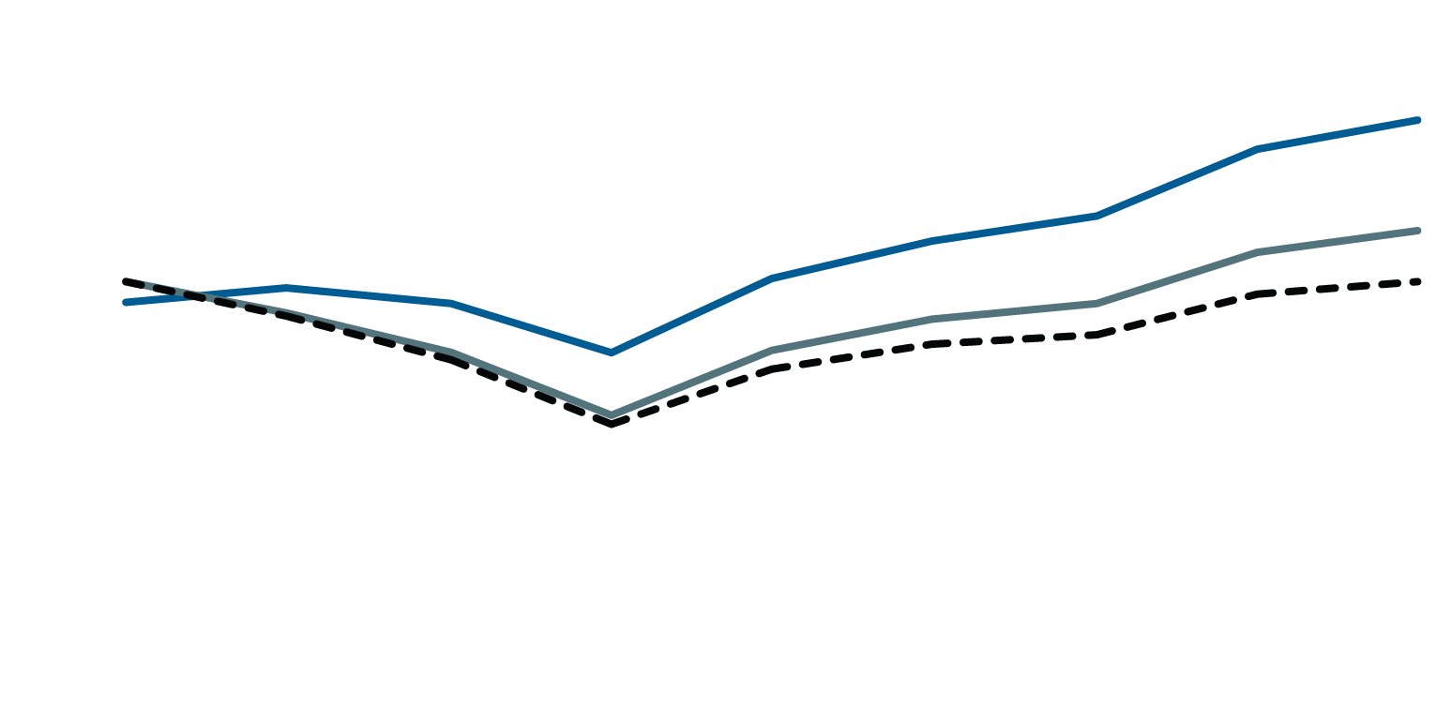
ICA vs. the S&P 500 Index
A Hypothetical $10,000 investment in a relatively flat market, 12/31/99–12/31/07
Ending value
Figures shown are past results and are not predictive of results in future periods. Current and future results may be lower or higher than those shown. Prices and returns will vary, so investors may lose money. Investing for short periods makes losses more likely. Fund results are for Class A shares and reflect deduction of the maximum sales charge (5.75%). For current information and month-end results,
visit capitalgroup.com.
$16,000
$14,537
ICA with dividends reinvested
12,000
$11,409
S&P 500
with
dividends reinvested
8,000
$9,994
S&P 500
4,000
2000
2001
2002
2003
2004
2005
2006
2007
There have been periods when the fund has lagged the index.
© 2026 Capital Group. All rights reserved.
Notes:
Before the 2007-2009 decline, the market had been relatively flat for the previous eight-year period.
– S&P 500 Index began the year 2000 with an index value of 1469.25 and ended 2007 with a value of 1468.36.
– A hypothetical investment of $10,000 in the S&P 500, with reinvested dividends, would have grown to $11,409.
– Meanwhile, a hypothetical $10,000 investment in ICA over the same period would have
grown to $14,537.
Of course, past results are not predictive of results in future periods, and there have been periods when the fund has lagged the index.
[Note to presenter: This presentation focuses on the period from 2000 through 2007. The examples and studies quoted deal with this period only. We feel the information from this decade, which contains both bull and bear markets, is still relevant to the investor mentality today.]

Slide 17
What we know for sure
Long-term investments in companies paying dividends have produced greater returns over time for investors
© 2026 Capital Group. All rights reserved.
Notes:
Long-term investments in companies paying dividends have helped generate greater returns over time for investors.

Slide 18
Dividends in cash
The Investment Company of America, 12/31/05–12/31/25
Ending value
$469,929
Figures shown are past results and are not predictive of results in future periods. Current and future results may be lower or higher than those shown. Prices and returns will vary, so investors may lose money. Investing for short periods makes losses more likely. Fund results are for Class A shares and reflect deduction of the 3.50% sales charge applicable to a $100,000 investment. For current information and month-end results, visit capitalgroup.com.
$100,000
$59,382
Original investment
12/31/05
Dividends in cash
Ending value
12/31/25
Assumes dividends taken in cash and capital gains reinvested.
© 2026 Capital Group. All rights reserved.
Notes:
For this $100,000 investment in ICA from December 31, 2005, through December 31, 2025, we're assuming that dividends were taken in cash and capital gains were reinvested. After 20 years:
– The income from dividends would have totaled $59,382.
– The ending value would have been $469,929.

Slide 19
What we know for sure
Diversification can reduce risk
The best investors look beyond short-term fluctuations
When investing, time is more important than timing
Investors can make money in flat markets
Historically, dividends from a portfolio of successful companies have risen over the long term
© 2026 Capital Group. All rights reserved.
Notes:
Now let’s review what we know for sure:
Diversification can reduce risk.
The best investors look beyond short-term fluctuations.
When investing, time is more important than timing.
Investors can make money in flat markets.
Historically, dividends from a portfolio of successful companies have risen over the long term.

Slide 20
What we know for sure
Selling at the bottom and buying at the top are natural for most people
© 2026 Capital Group. All rights reserved.
Notes:
Over the years, the main thing we’ve all learned — and still know for sure — is that selling at the bottom and buying at the top is the goal for most people.
Looking at ICA’s history may help you avoid this mistake.

Slide 21
ICA investment results
Rolling calendar-year periods ending 12/31/25
Figures shown are past results and are not predictive of results in future periods. Current and future results may be lower or higher than those shown. Prices and returns will vary, so investors may lose money. Investing for short periods makes losses more likely. Fund results are for Class A shares and reflect deduction of the maximum sales charge (5.75%). For current information and month-end results,
visit capitalgroup.com.
67%
Positive periods: 62
Positive periods: 79
Negative periods: 30
Negative periods: 11
7%
93%
Positive periods: 82
Positive periods: 83
Negative periods: 6
Negative periods: 0
Average annual total
returns as of 3/31/26
1 year
5 years
10 years
Expense ratio
The Investment Company of America 11.40% 11.37% 12.52% 0.55%
Investment results assume all distributions are reinvested and reflect applicable fees and expenses. The expense ratio is as of the fund’s prospectus available at the time of publication. When applicable, results reflect fee waivers and/or expense reimbursements, without which they would have been lower. Visit capitalgroup.com for more information.
© 2026 Capital Group. All rights reserved.
Notes:
Historically, investors who have a long-term focus and the discipline to stay invested during the occasional and inevitable periods of declines in stock prices have been rewarded.
Over calendar-year periods from January 1, 1934, through December 31, 2025, you quickly can see that ICA’s one-year results were more likely to be negative than results for longer periods.
– In fact, the number of negative three-year periods is almost half the number of
negative one-year periods.
– And ICA’s results for every 10-year period were positive.

Slide 22
Important information
Investors should carefully consider investment objectives, risks, charges and expenses. This and other important information is contained in the fund prospectuses and summary prospectuses, which can be obtained from a financial professional and should be read carefully before investing.
This content, developed by Capital Group, home of American Funds, should not be used as a primary basis for investment decisions and is not intended to serve as impartial investment or fiduciary advice.
All Capital Group trademarks mentioned are owned by The Capital Group Companies, Inc., an affiliated company or fund. All other company and product names mentioned are the property of their respective companies.
Capital Client Group, Inc.
Diversification does not guarantee investment returns or eliminate risk of loss in a declining market.
© 2026 Capital Group. All rights reserved.
Notes:
Refer to slide.

Slide 23
Important information
Dow Jones Industrial Average (DJIA) is a price-weighted average of 30 actively traded industrial and service-oriented blue chip stocks.
S&P 500 Index is a market capitalization-weighted index based on the results of 500 widely held common stocks.
The S&P 500 Index (“Index”) and the DJIA ("Index") are products of S&P Dow Jones Indices LLC and/or its affiliates and has been licensed for use by Capital Group. Copyright © 2026 S&P Dow Jones Indices LLC, a division of S&P Global, and/or its affiliates. All rights reserved. Redistribution or reproduction in whole or in part are prohibited without written permission of S&P Dow Jones Indices LLC.
Market indexes are unmanaged and, therefore, have no expenses. Investors cannot invest directly in an index.
If used after June 30, 2026, this presentation must be accompanied by the most recent American Funds quarterly statistical update.
© 2026 Capital Group. All rights reserved.
Notes:
Refer to slide.

Slide 24


Thank you.
© 2026 Capital Group. All rights reserved.
Notes:
Refer to slide.

